Slide 1
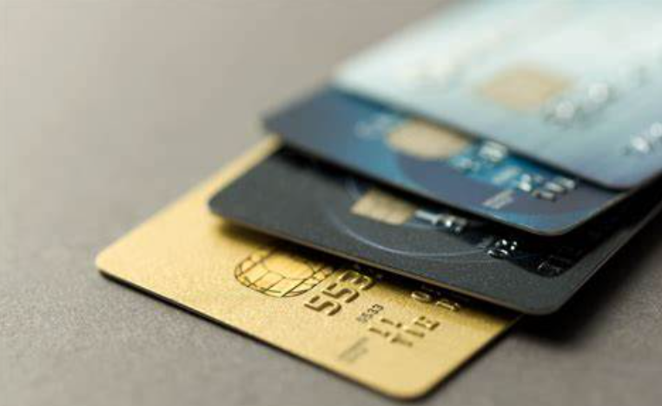
Credit Card Fraud Detection
Capstone project
Sanit Yadav
Sirisha Polamuri
Rakesh Modak

Slide 2
Outline
Problem Statement
Objective
Key Insights; Data Analysis
Models; ML Algorithms
Business Impact: Cost Benefit Analysis
Recommendation
Appendix
Data type and variables
ROSE- data imbalance handling

Slide 3
Problem Statement
Introduction:
Credit card fraud is any dishonest act or behavior to obtain information without the proper authorization of the account holder for financial gain. There are numerous ways of making fraudulent transactions:
Skimming
Manipulation or alteration of genuine cards
Creation of counterfeit cards
Stolen or lost credit cards
Fraudulent telemarketing
Implications:
Concerning dependency on plastic money: As credit card transactions become the most prevailing mode of payment for both online and offline transaction, the fraud rate also accelerates resulting a major concern for financial institutions as well as consumers.
Financial loss and reputation damage: Fraudulent transactions not only result in financial loses for banks, but can damage their reputation and lose the trust of customers.
Need for proactive monitoring and fraud prevention: The increase in online transactions over the past decade has made real-time detection and prevention of financial fraud even more important and need for a prevention mechanism has become more apparent.
Solution
Machine learning can help prevent this fraud act and helping these institutions in numerous ways, such as:
reduce time-consuming manual reviews
costly chargebacks and fees
denial of legitimate transactions

Slide 4
Objective
Mitigating the fraud risk: need to recommend a credit card fraud detection system to help bank to save cost incurred due to fraud transactions and prevent the monetary loss
Optimal ML model: the aim is to suggest a ML algorithm to identify the frauds correctly which means the number of wrong classification should be minimum
Better customer experience: help in preventing the damage to the bank’s reputation and reduced customer base
Action Points to achieve the objectives:
To achieve the objective of the project is first to train a machine learning algorithm on the dataset to successfully predict fraudulent transactions
Data Understanding- all feature/variables and data types
Performing the EDA (exploratory data analysis)- pre-process the dataset, briefly exploring features & engineering new features where possible
Build the most effective ML model to detect the frauds
Select an optimal cut-off for the model
Estimate the business impact and potential savings

Slide 5
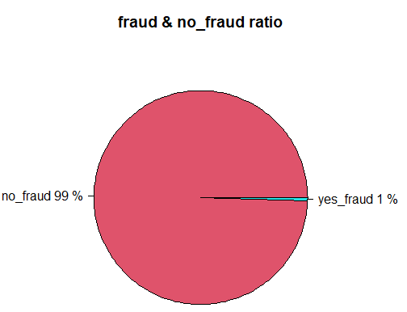
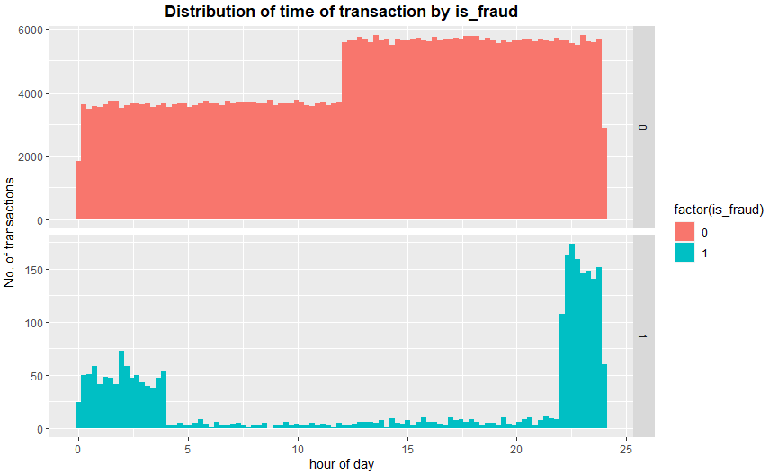
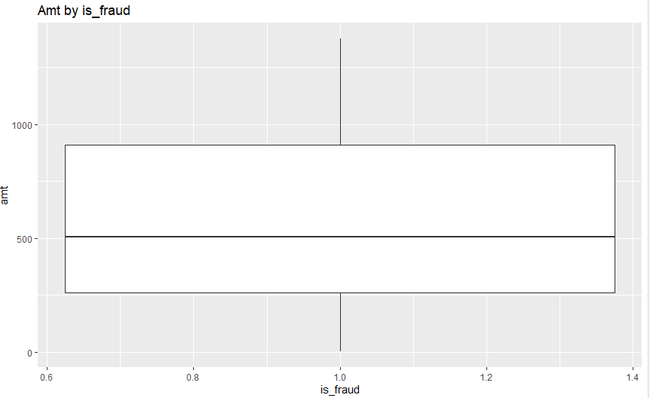
Key Insights: Data Analysis
Fraud & no_fraud ratio:
99.4% of the data are valid or non fraudulent transactions and only 0.6% are fraudulent.
Distribution of transactions by Time:
The fraud transactions occur more between 9 PM to 2 AM at night.
Distribution of Amount with Fraud Transactions only:
The Fraudulent transactions are normally of lower amount
It can be inferred that the amount is spread between 259 to approx. 800 with mean at 500.
Data is highly Imbalanced

Slide 6
Models: ML Algorithms
We have trained the data on 3 supervised ML algorithms which are used for classification and have compared the output to finalise the best model to recommend for deployment in the bank to prevent fraud cases, all 3 output are as follows:
Logistic Regression: fitted using ROSE sampling
AUC : 0.954
Random Forest: fitted using ROSE sampling
AUC : 0.9090
Decision Tree: fitted using ROSE sampling
AUC : 0.9377

Slide 7
Business Impact: Cost & Benefit Analysis
Monthly Cost Incurred: before model deployment the average monthly cost is $54508 which significantly drops to $2002 after deploying the Random Forest model on the data
Monthly cost Incurred and savings: with the help of Random forest model the monthly average cost drastically goes down from 100% to 4% and resulting in 96% of the savings hence the model is strongly recommended to deploy
Monthly Cost for undetected: average monthly undetected fraud transactions reduces by 96% (100% -4%) if we deploy Random Forest Model

Slide 8
Recommendations
We recommend adoption of Random Forest model with ROSE sampling technique as the data is highly imbalanced
The ML model is highly recommended to be deployed as avoiding even a single fraudulent transaction is costing $543,however the support cost is only $1.5
The deployment of model is indispensably required in the bank which can detect the maximum possible fraudulent transactions, however, the model may also classify the non fraudulent transactions into fraud which is called false positives, but if the number is low comparatively then it will not have much impact as the cost is less
While trying 3 models, the results with Random Forest came out to be the best, hence Random Forest is highly recommended to be deployed.

Slide 9
Thank You

Slide 10
Appendix- Data type and variables
The data set contains credit card transactions of around 1,000 cardholders with a pool of 800 merchants from 1 Jan 2019 to 31 Dec 2020. This is a simulated credit card transaction dataset containing legitimate and fraud transactions from the duration 1st Jan 2019 - 31st Dec 2020. It contains credit card transactions of around 1,000 cardholders with a pool of 800 merchants. It contains a total of 18,52,394 transactions, out of which 9,651 are fraudulent transactions.
The variable details of the data set are as follows:
‘Is_fraud’ column is our response variable and it takes value 1 in case of fraud and 0 otherwise.
All other variables in the data are predictors
The data type of all variables are as follows:
Categorical Variables (14): cc_num, Merchant, Category, Gender, city, state, ZIP,job,is_fraud,City_pop
Continuous variables (5): row seq no, amt,lat,long, dob,Trans_num,Unix_time, Merch_lat, Merch_long
Variable Name | Description
trans_date_trans_time | Time stamp of transaction date and time
cc_num | Credit card number
Merchant | Merchant description (1000 distinct values) with whom the transaction is made
Category | Category of the merchant (14 distinct categories)
Amt | transaction amount
First | First name of the Credit card holder
Last | Last name of the Credit card holder
Gender | Gender of the Credit card holder
Street | Address of the Credit card holder
City | City of the Credit card holder
State | State of the Credit card holder
Zip | Zipcode
Lat | Latitude of the Credit card holder location
Long | longitude of the Credit card holder location
City_pop | Population of the city
Job | Job of the Credit card holder
Dob | Date of birth of the Credit card holder
Trans_num | Transaction number
Unix time
Merch_lat | Latitude of the merchant location
Merch_long | longitude of the merchant location
Is_fraud | Is transaction is fraudulent or not

Slide 11
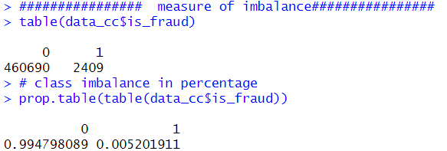
Appendix- Data Imbalance Handling
ROSE (Random Over-Sampling Examples) aids the task of binary classification in the presence of rare classes. It produces a synthetic, possibly balanced, sample of data simulated according to a smoothed-bootstrap approach. Therefore, the combination of over & under-sampling will be used to process the dataset before modelling. By doing that, the proportion of fraud transaction in training set would be about 50%, (refer below R code and its output):
Over & Under Sampling method: below is the snippet of R code before and after along with output
Before Sampling the proportion is as below:
After Sampling with ROSE, the proportion is as below:

